Slide 1
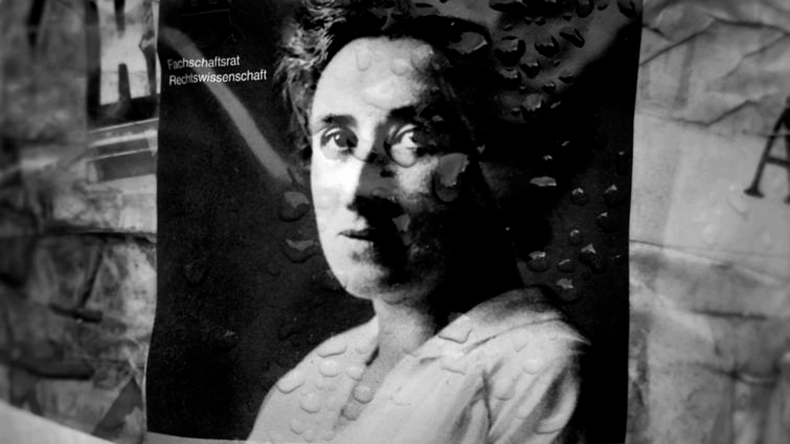
Archive Tales: Negotiating the Radical Personal Film Archive
Rosa Luxemburg, Resisters, screen shot

Slide 2
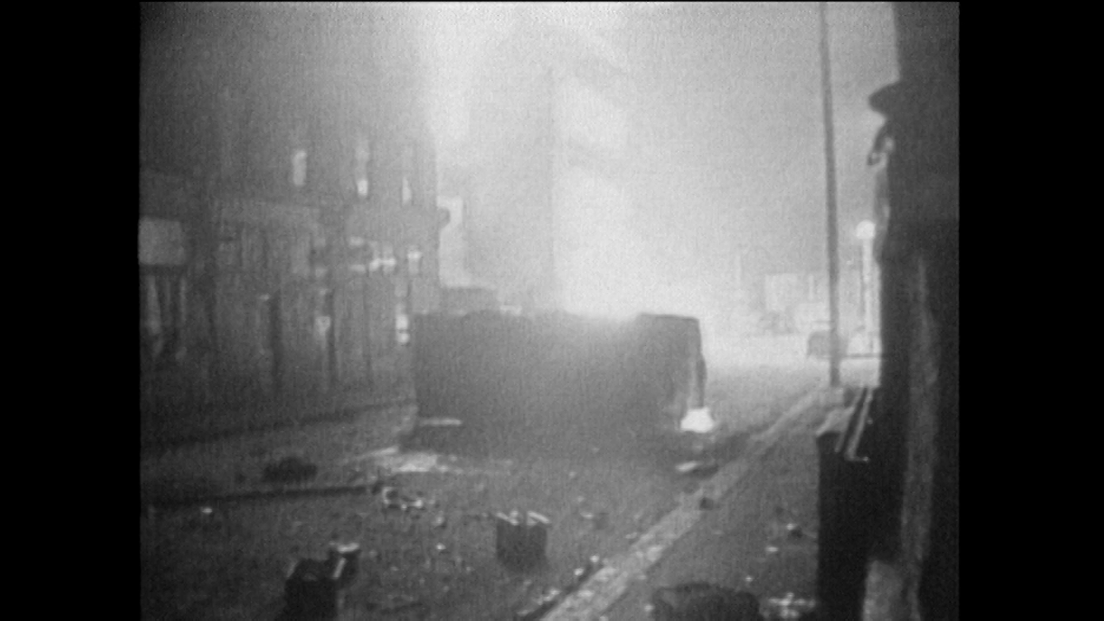
Archive Tales: Negotiating the Radical Personal Film Archive
My documentary films mediate memory and history, and are aimed to bypass constraints of evidence, authenticity or certainty. I began making films on 16mm analogue film. The development of mobile digital media opened possibilities for a more intimate and immediate access to subjects and locations; to enable filming alone and unencumbered by heavy film equipment. Now my collaboration is with subjects rather than film crews.
Screenshot, If Not Now

Slide 3
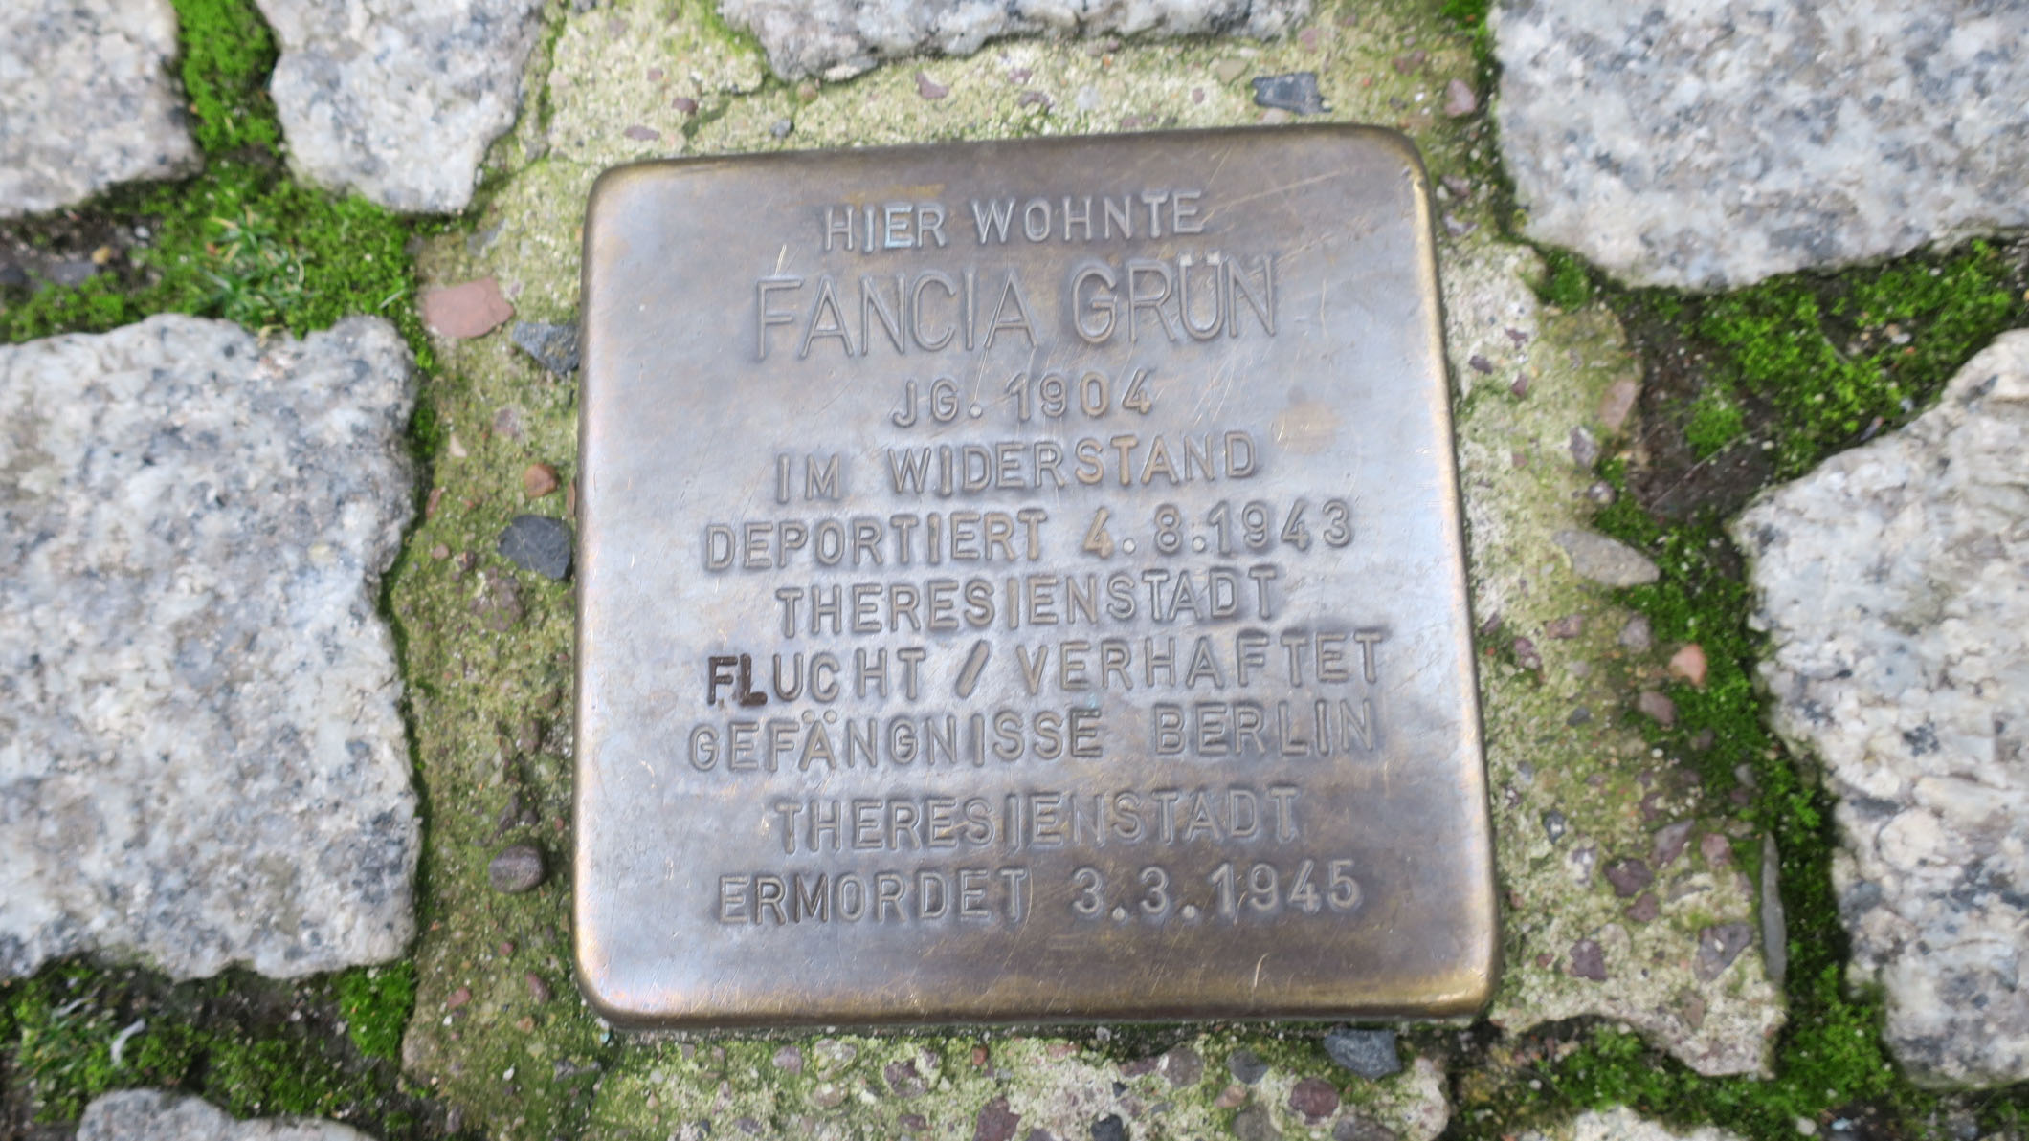
Archive Tales: Negotiating the Radical Personal Film Archive
I take an essayistic approach akin to the idea of the ‘bricoleuse’ or the handy woman who experiments with various different arrangements of elements to see if they will ‘work’ or not. I note the increasing growth of right-wing nationalism and war and my recent films are autobiographical conveyed through voice-overs and archive.
Resisters, screenshot

Slide 4
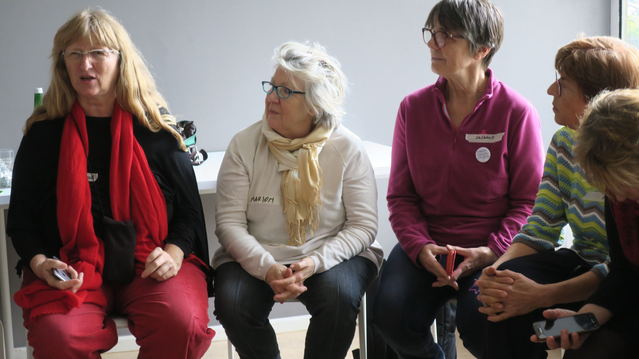
Archive Tales: Negotiating the Radical Personal Film Archive
Hito Steyerl wrote in 2010, ‘Aesthetics of Resistance? Artistic Research As Discipline and Conflict’ – aesthetic research related to the history of anti-fascist resistance from 1933 to 1945.
Avery Gordon: Haunting is a struggle against the reduction of individuals “to a sequence of instantaneous experiences that leave no trace” or whose trace (as dust) is hated as irrational, superfluous and ‘overtaken’. Avery Gordon: Haunting is a struggle against the reduction of individuals “to a sequence of instantaneous experiences that leave no trace” or whose trace (as dust) is hated as irrational, superfluous and ‘overtaken’.
Avery Gordon: Haunting is a struggle against the reduction of individuals “to a sequence of instantaneous experiences that leave no trace” or whose trace (as dust) is hated as irrational, superfluous and ‘overtaken’.
Screeenshot, Resisters, Omas Gegen Rechts (Grandmothers Against the Right

Slide 5
Archive Tales: Negotiating the Radical Personal Film Archive
Steyerl noted that throughout history moments of extreme conflict and crisis gave rise to the development of a new range of aesthetic approaches to artistic research which may serve to undermine the dominant division of labour.

Slide 6
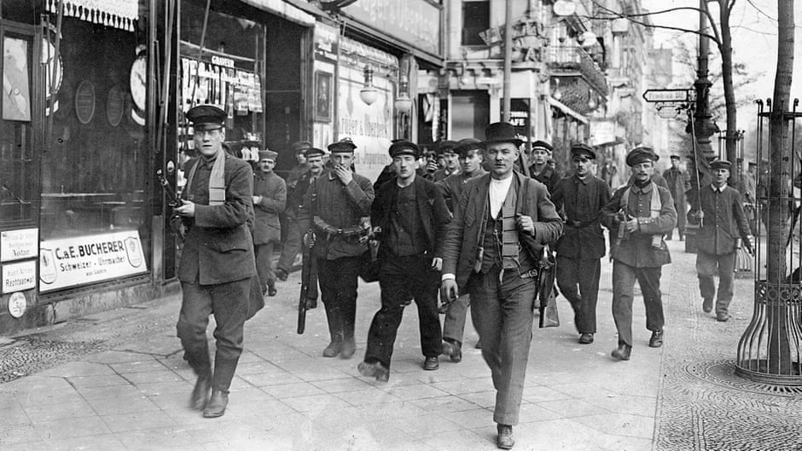
Archive Tales: Negotiating the Radical Personal Film Archive
In my films my overall concern is, as Jane Gaines says: “with the question of what it might be that moves viewers to want to act, that moves them to do something instead of nothing in relation to the political situation illustrated on the screen (Gaines, 1999).
Revolution, Resisters, Screenshot

Slide 7
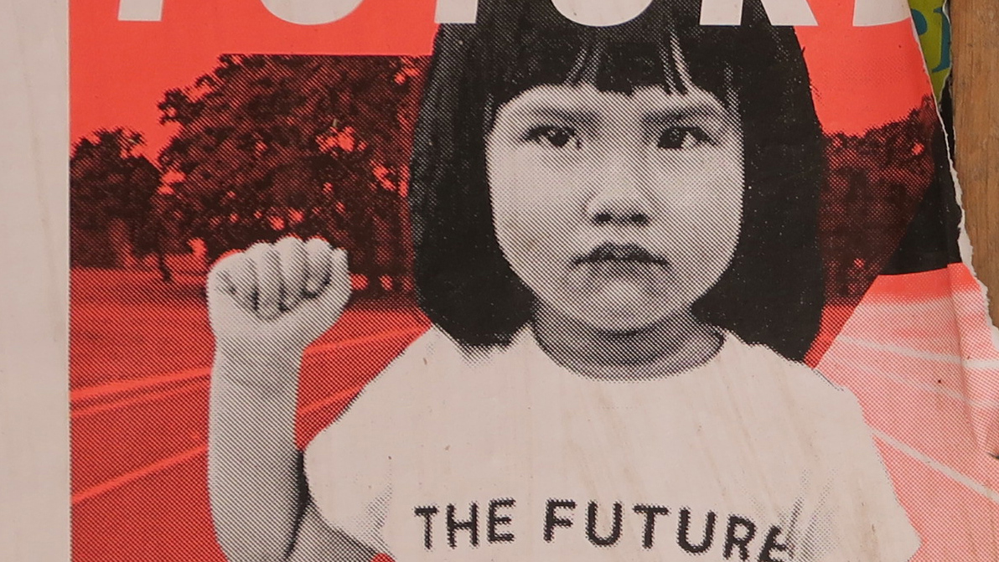
Archive Tales: Negotiating the Radical Personal Film Archive
Doane says: “There are always at least two temporalities at work in film. Accompanying the spectatorial experience of the present tense of the filmic flow is the recognition that the images were produced at a particular time, that they are inevitably stained with their own historicity” Doane (2002)
Breathing Still & Resisters, poster Berlin, Screenshots.

Slide 8
Archive Tales: Negotiating the Radical Personal Film Archive
As an experimental documentary filmmaker I am drawn to the use of a digital database to store footage obtained through low-end cameras, mobile devices, archive or found footage–including their own past films–analogue and digital, to provide me with an endless storehouse of digital documents that can easily be accessed and reused in infinite ways to create new practice (Baron, 2014).

Slide 9
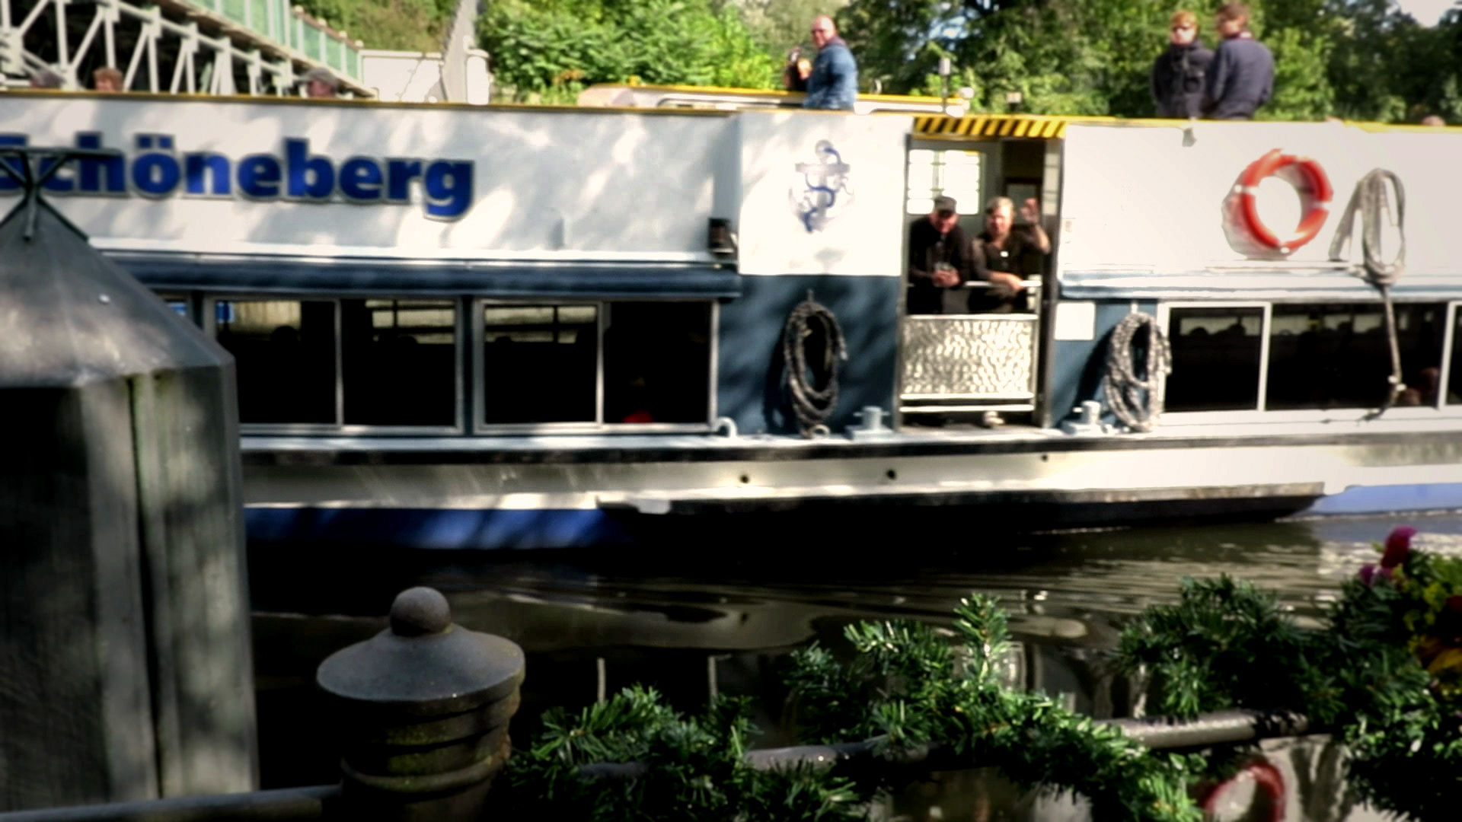
Archive Tales: Negotiating the Radical Personal Film Archive
The archive says Carolyn Steedman “is to do with longing and appropriation. It is do with wanting things that are put together, collected, collated, named in lists and indices, a place where a whole world, a social order, may be imagined” but the visits “cannot help with what is not actually there” (Steedman, 2001) so the images and sound from the archive must be transformed and re-imagined alongside new filmed footage.
Avery Gordon: Haunting is a struggle against the reduction of individuals “to a sequence of instantaneous experiences that leave no trace” or whose trace (as dust) is hated as irrational, superfluous and ‘overtaken’. Avery Gordon: Haunting is a struggle against the reduction of individuals “to a sequence of instantaneous experiences that leave no trace” or whose trace (as dust) is hated as irrational, superfluous and ‘overtaken’.
Avery Gordon: Haunting is a struggle against the reduction of individuals “to a sequence of instantaneous experiences that leave no trace” or whose trace (as dust) is hated as irrational, superfluous and ‘overtaken’.
Breathing Still & Resisters, screenshot

Slide 10
Archive Tales: Negotiating the Radical Personal Film Archive
Sequences collected in a database need to have some intentionality through a discursive structure that they do not possess as inert footage in order to become relevant or meaningful (Ellis, 2012).

Slide 11
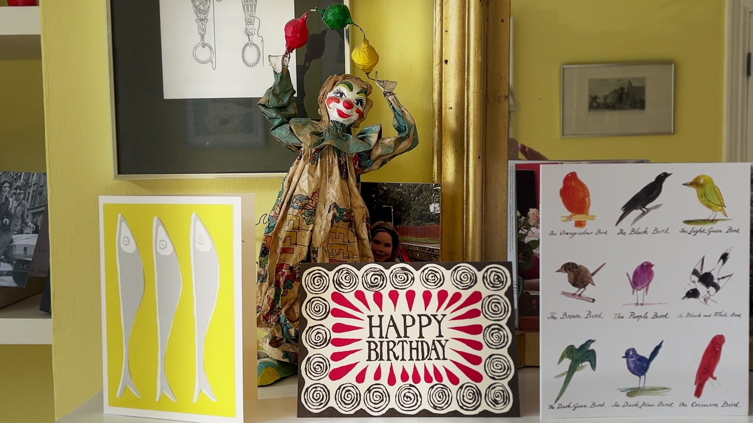
Archive Tales: Negotiating the Radical Personal Film Archive
Much of my footage is digitized from analogue formats to make essayistic films that critically engage with a past in order to create radical films to reclaim what might have hidden or lost and remains only in traces, where the images and sounds inevitably bear “the traces of the moment at which they were produced.” (Doane, 2002)
19481948 What We Knew, screenshot

Slide 12
Archive Tales: Negotiating the Radical Personal Film Archive
The effect of slow motion may appear dream-like but is distinct from a dream, because dreams are about the expression of repressed desires rather than the formal quality of their images (Bazin, 1997).

Slide 13
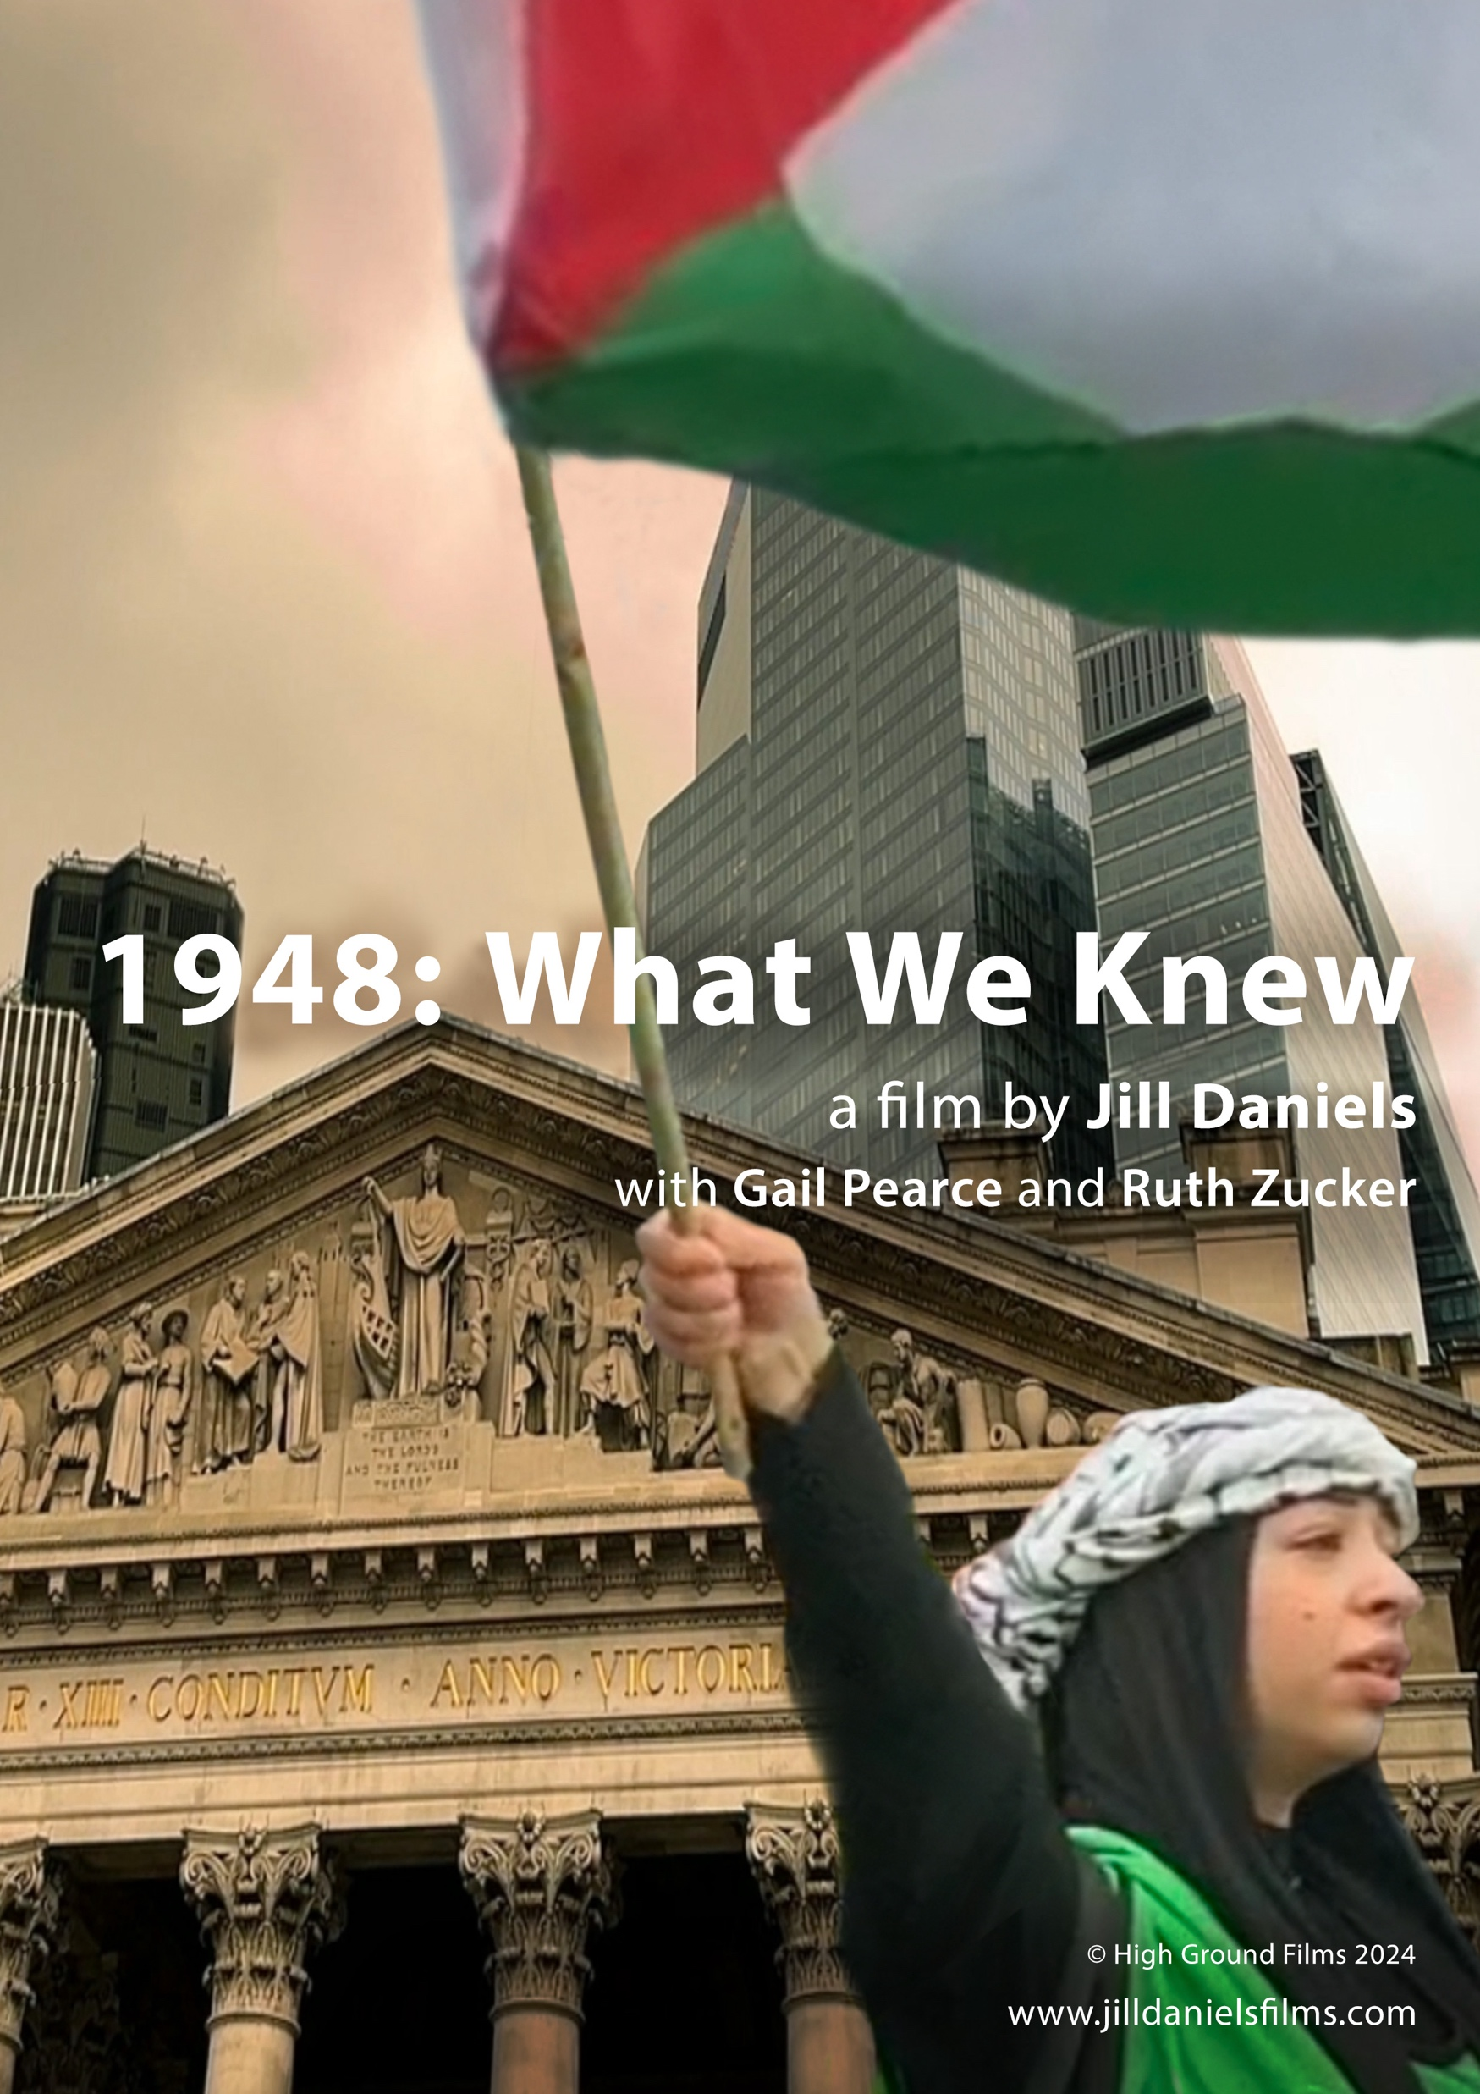
Archive Tales: Negotiating the Radical Personal Film Archive
Avery Gordon: Haunting is a struggle against the reduction of individuals “to a sequence of instantaneous experiences that leave no trace” or whose trace (as dust) is hated as irrational, superfluous and ‘overtaken’. Avery Gordon: Haunting is a struggle against the reduction of individuals “to a sequence of instantaneous experiences that leave no trace” or whose trace (as dust) is hated as irrational, superfluous and ‘overtaken’.
Avery Gordon: Haunting is a struggle against the reduction of individuals “to a sequence of instantaneous experiences that leave no trace” or whose trace (as dust) is hated as irrational, superfluous and ‘overtaken’.
In my film 1948 What We Knew, an autobiographical essay film about Jewish women born in 1948, the same year as the Israeli state, I explore the fairy tales we were told. The off-screen voice-over conversations offer a fabricated point of view and an intimacy in the closeness acquired by the use of a smartphone to make this film.

Slide 14
Jill Daniels
www.jilldanielsfilms.com

